Slide 1
INTERNSHIP CAR RENTAL SYSTEM
BY:
DEEPTHI NAYAK
4NM20MC021
MCA, NITTE

Slide 2
INTRODUCTION
The project is designed to help people utilize transport effectively.
In recent times cars have become most convenient modes of transportation.
Our Car rental system helps in making this an easier, hassle-free and enjoyable experience to acquire and use a car as per ones needs.
A person can book a car specifically for his travel time, co-travelers and the nature of travel.
The rental system traverses from designing a database to understanding business concept and above all to make this an easy to adapt system for various travelling needs.

Slide 3
MODULES
ADMIN
CLIENT

Slide 4
Admin Modules
Login
Upload Products
Manage bookings
Manage payments
Reply to clients
View reviews
Client details

Slide 5
Client Modules
Register
Search for products
View products
Booking
Payments
Contact us

Slide 6
DATABASE TABLES
Admin
Products
Bookings
Payment
Users
Contact
Reply

Slide 7
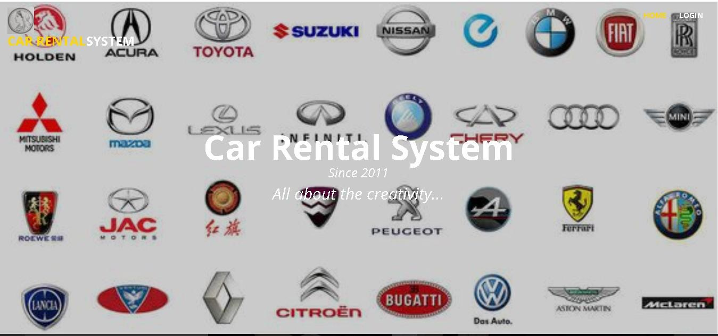
Home Page

Slide 8
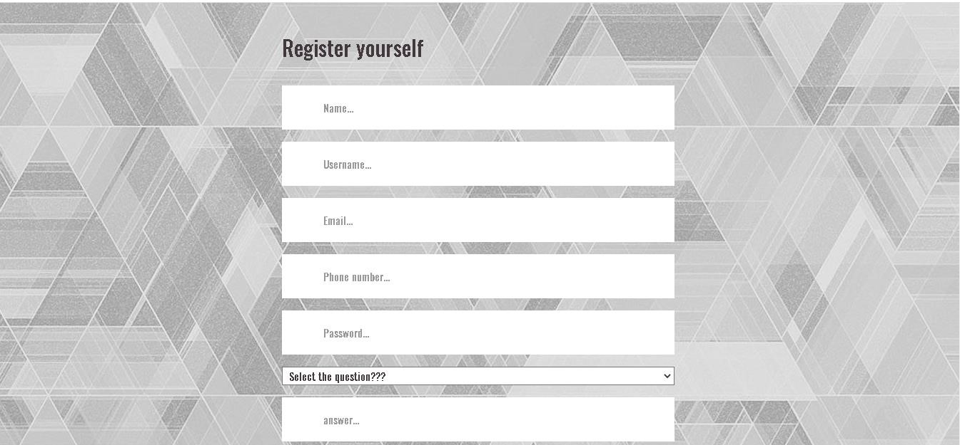
Register Page

Slide 9
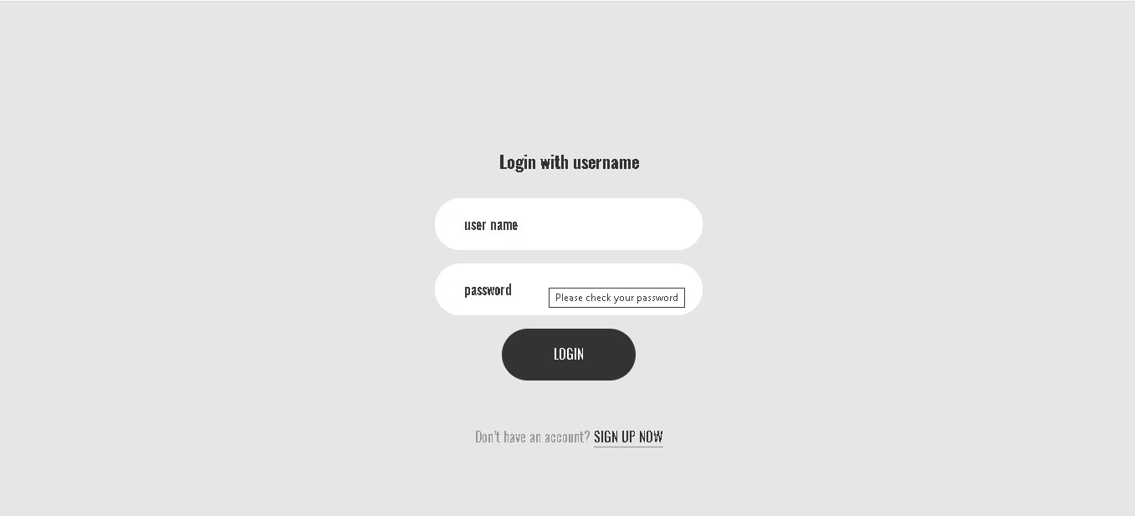
Login Page

Slide 10
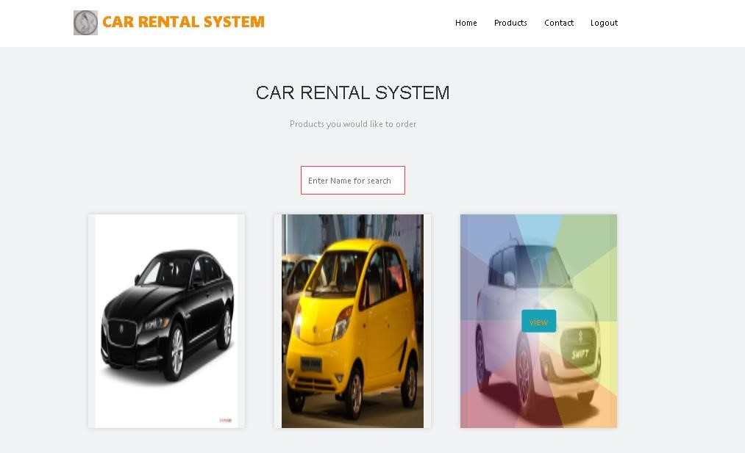
View Products Page

Slide 11
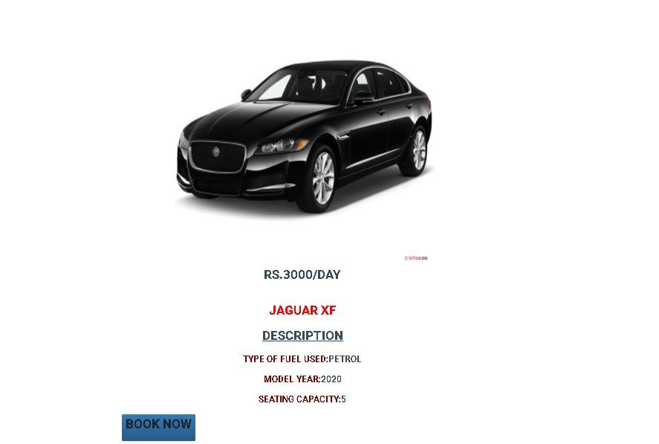
Booking Page

Slide 12
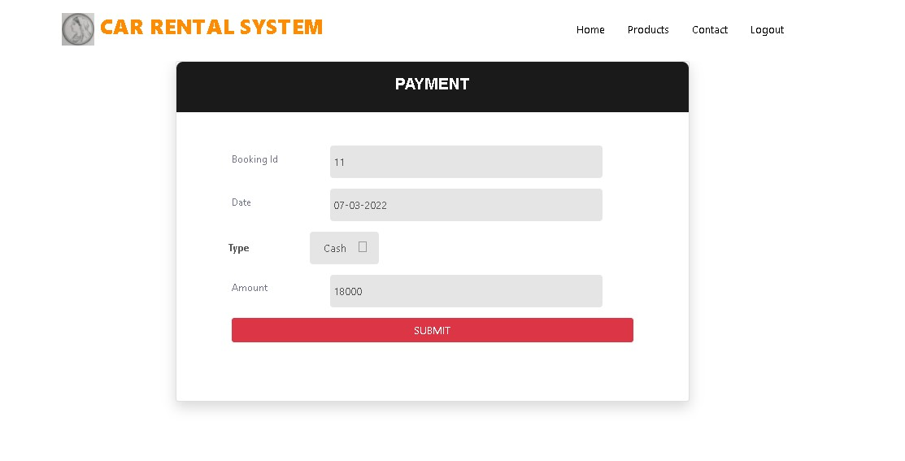
Payment Page

Slide 13
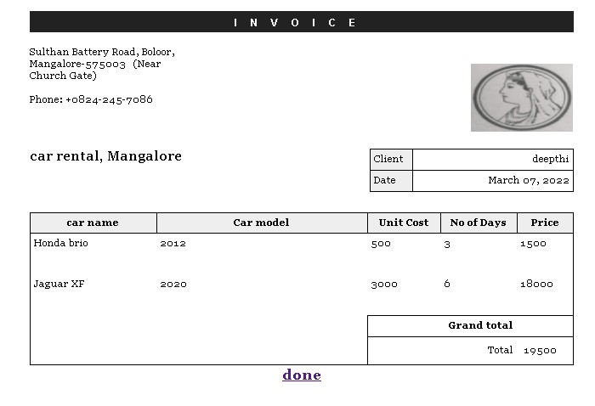
Invoice

Slide 14
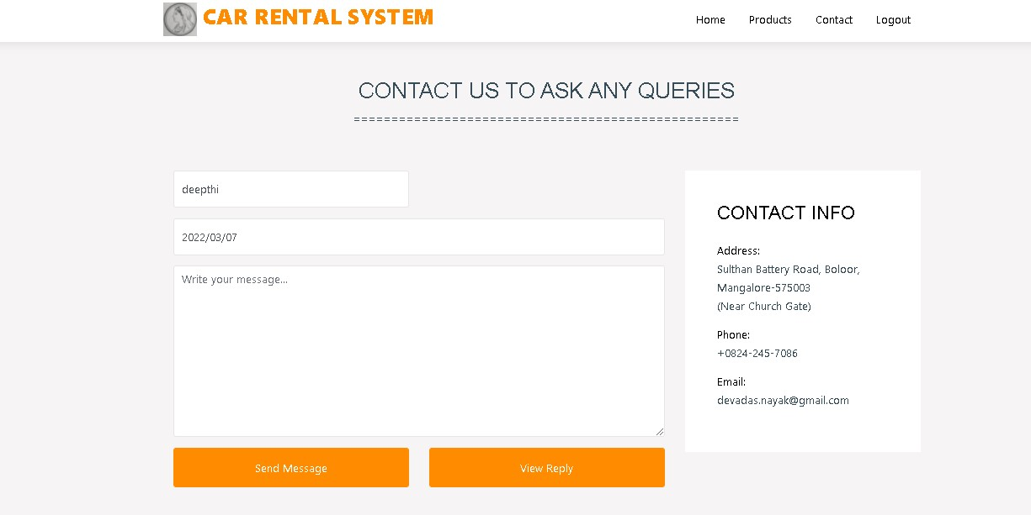
Contact us Page

Slide 15
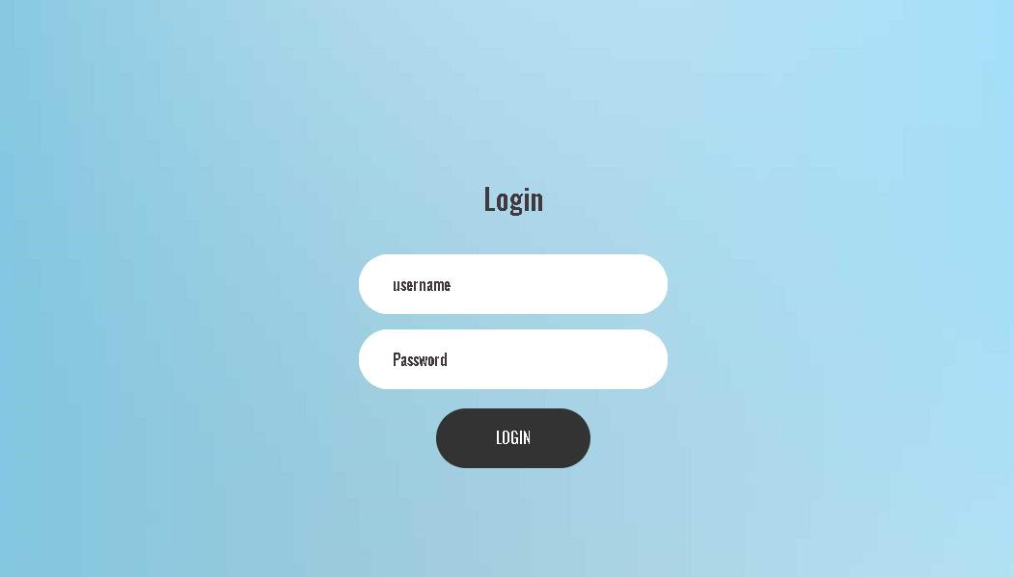
Admin Login

Slide 16
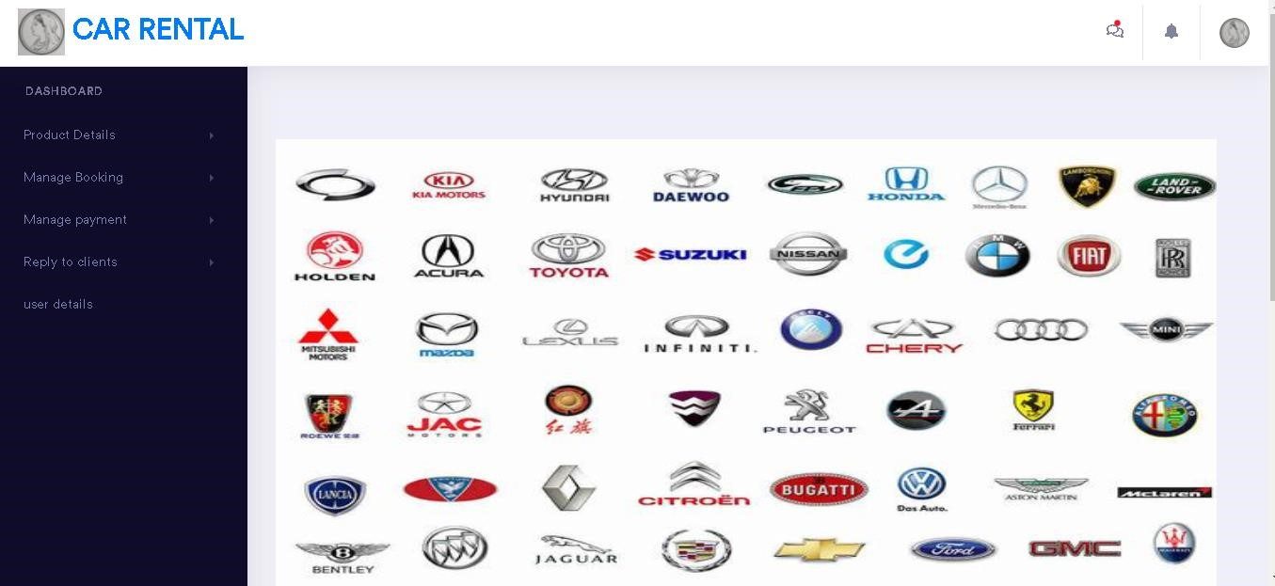
Dashboard

Slide 17
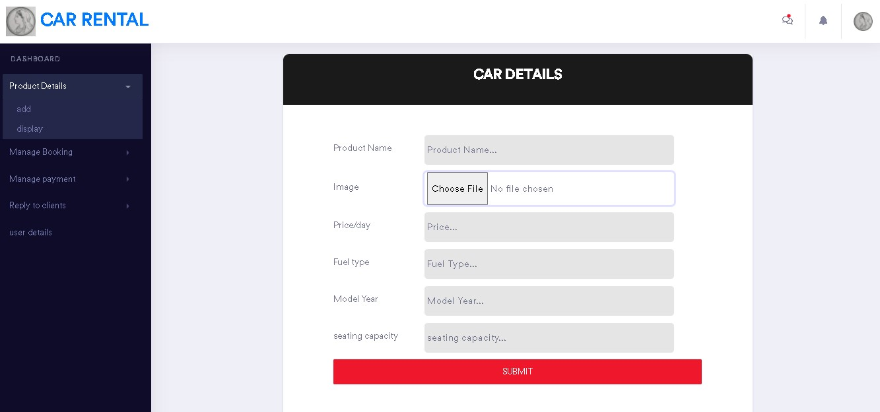
Add Products

Slide 18
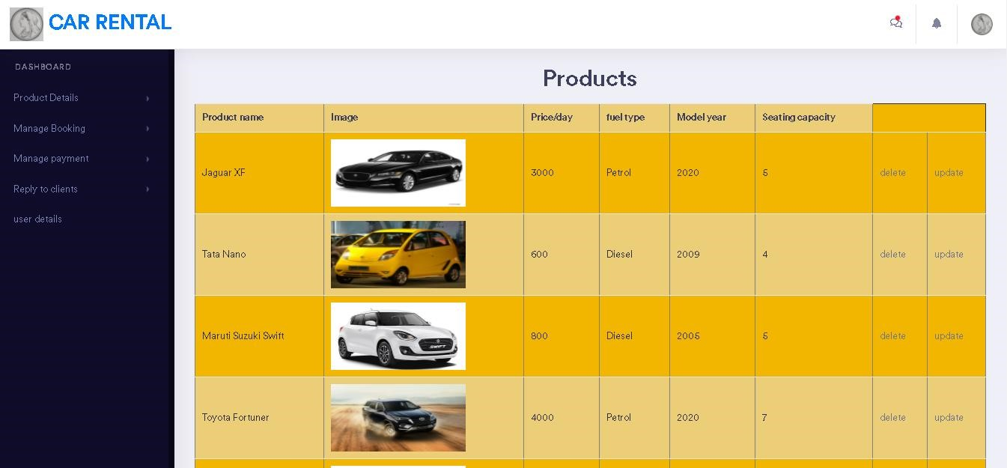
Add Products

Slide 19
CONCLUSION
Car rental business has emerged with a new goody compared to the past experience where every activity concerning car rental business is limited to a physical location only.
Even though the physical location has not been totally eradicated; the nature of functions and how these functions are achieved has been reshaped by the power of internet.
Nowadays, customers can reserve cars online, rent car online, and have the car brought to their door step once the customer is a registered member or go to the office to pick the car.

Slide 20
FUTURE ENHANCEMENT
Implementing many more features for this application.
Trying to make it more user-friendly.
Trying to integrate it with mobile application.

Slide 21
THANK YOU

